Slide 1
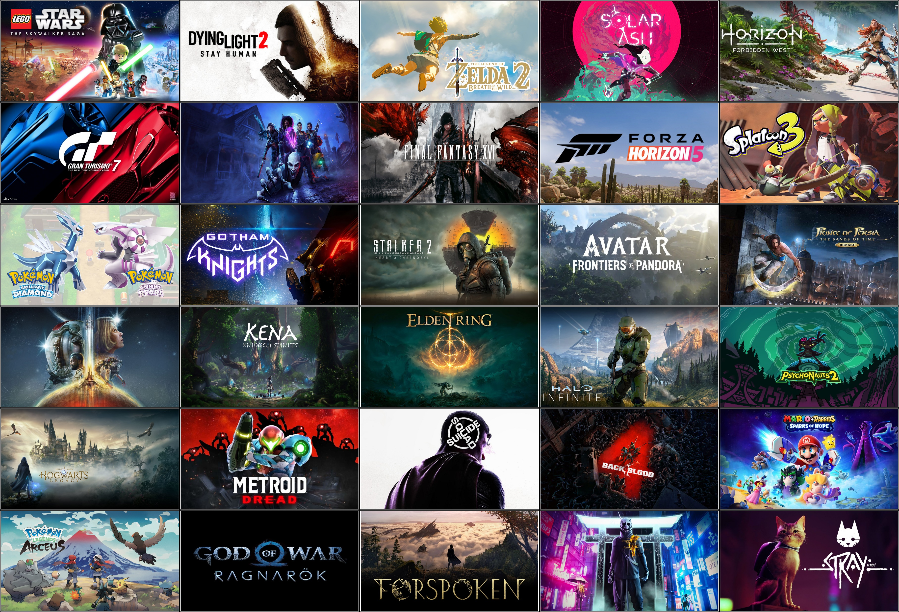


Automatic Integration,
Analysis and Presentation Data System
of Global Game Products' Quality
in 2020-2022 (COVID-Period)
AIDM 7360
The Lord of Sham Shui Po © JIANG Zhuohao YU Minghao HE Yuchen

Slide 2
BACKGROUND
Three-year-lasted COVID-19 epidemic has caused an enormous impact on global entertainment industry, and gaming industry, which has been estimated to reach a yearly revenue of $208.6 billion USD (according to Stasista, Oct 2022) , is one of the most affected parts.
To assess the impact of the epidemic on the industry as industry observants, conducting a full-scale analysis on the quality of game products during the pass-three-year epidemic is easily considered to be essential and informative.

Slide 3

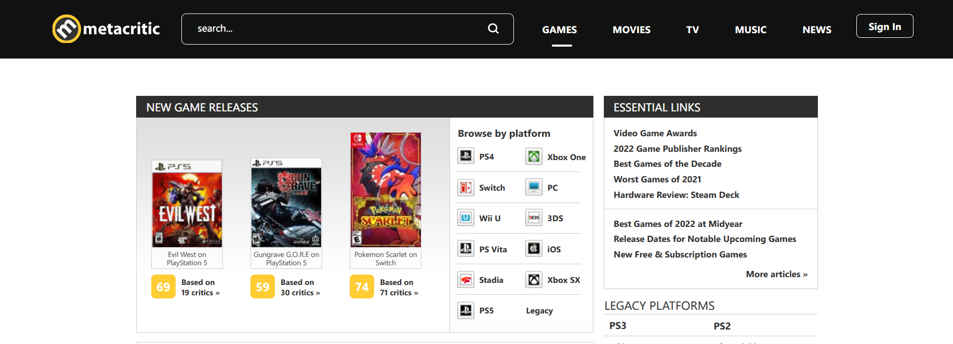

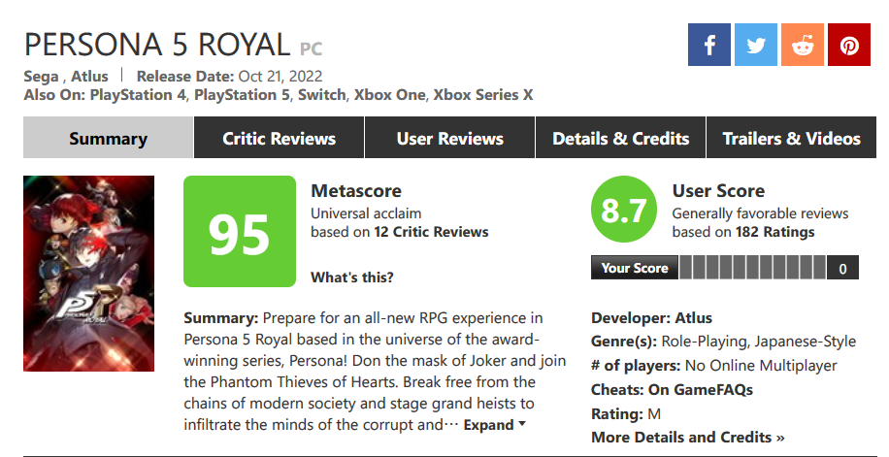
BACKGROUND
The biggest and most influential
worldwide collector of
information &
critic/user reviews
of game product

Slide 4




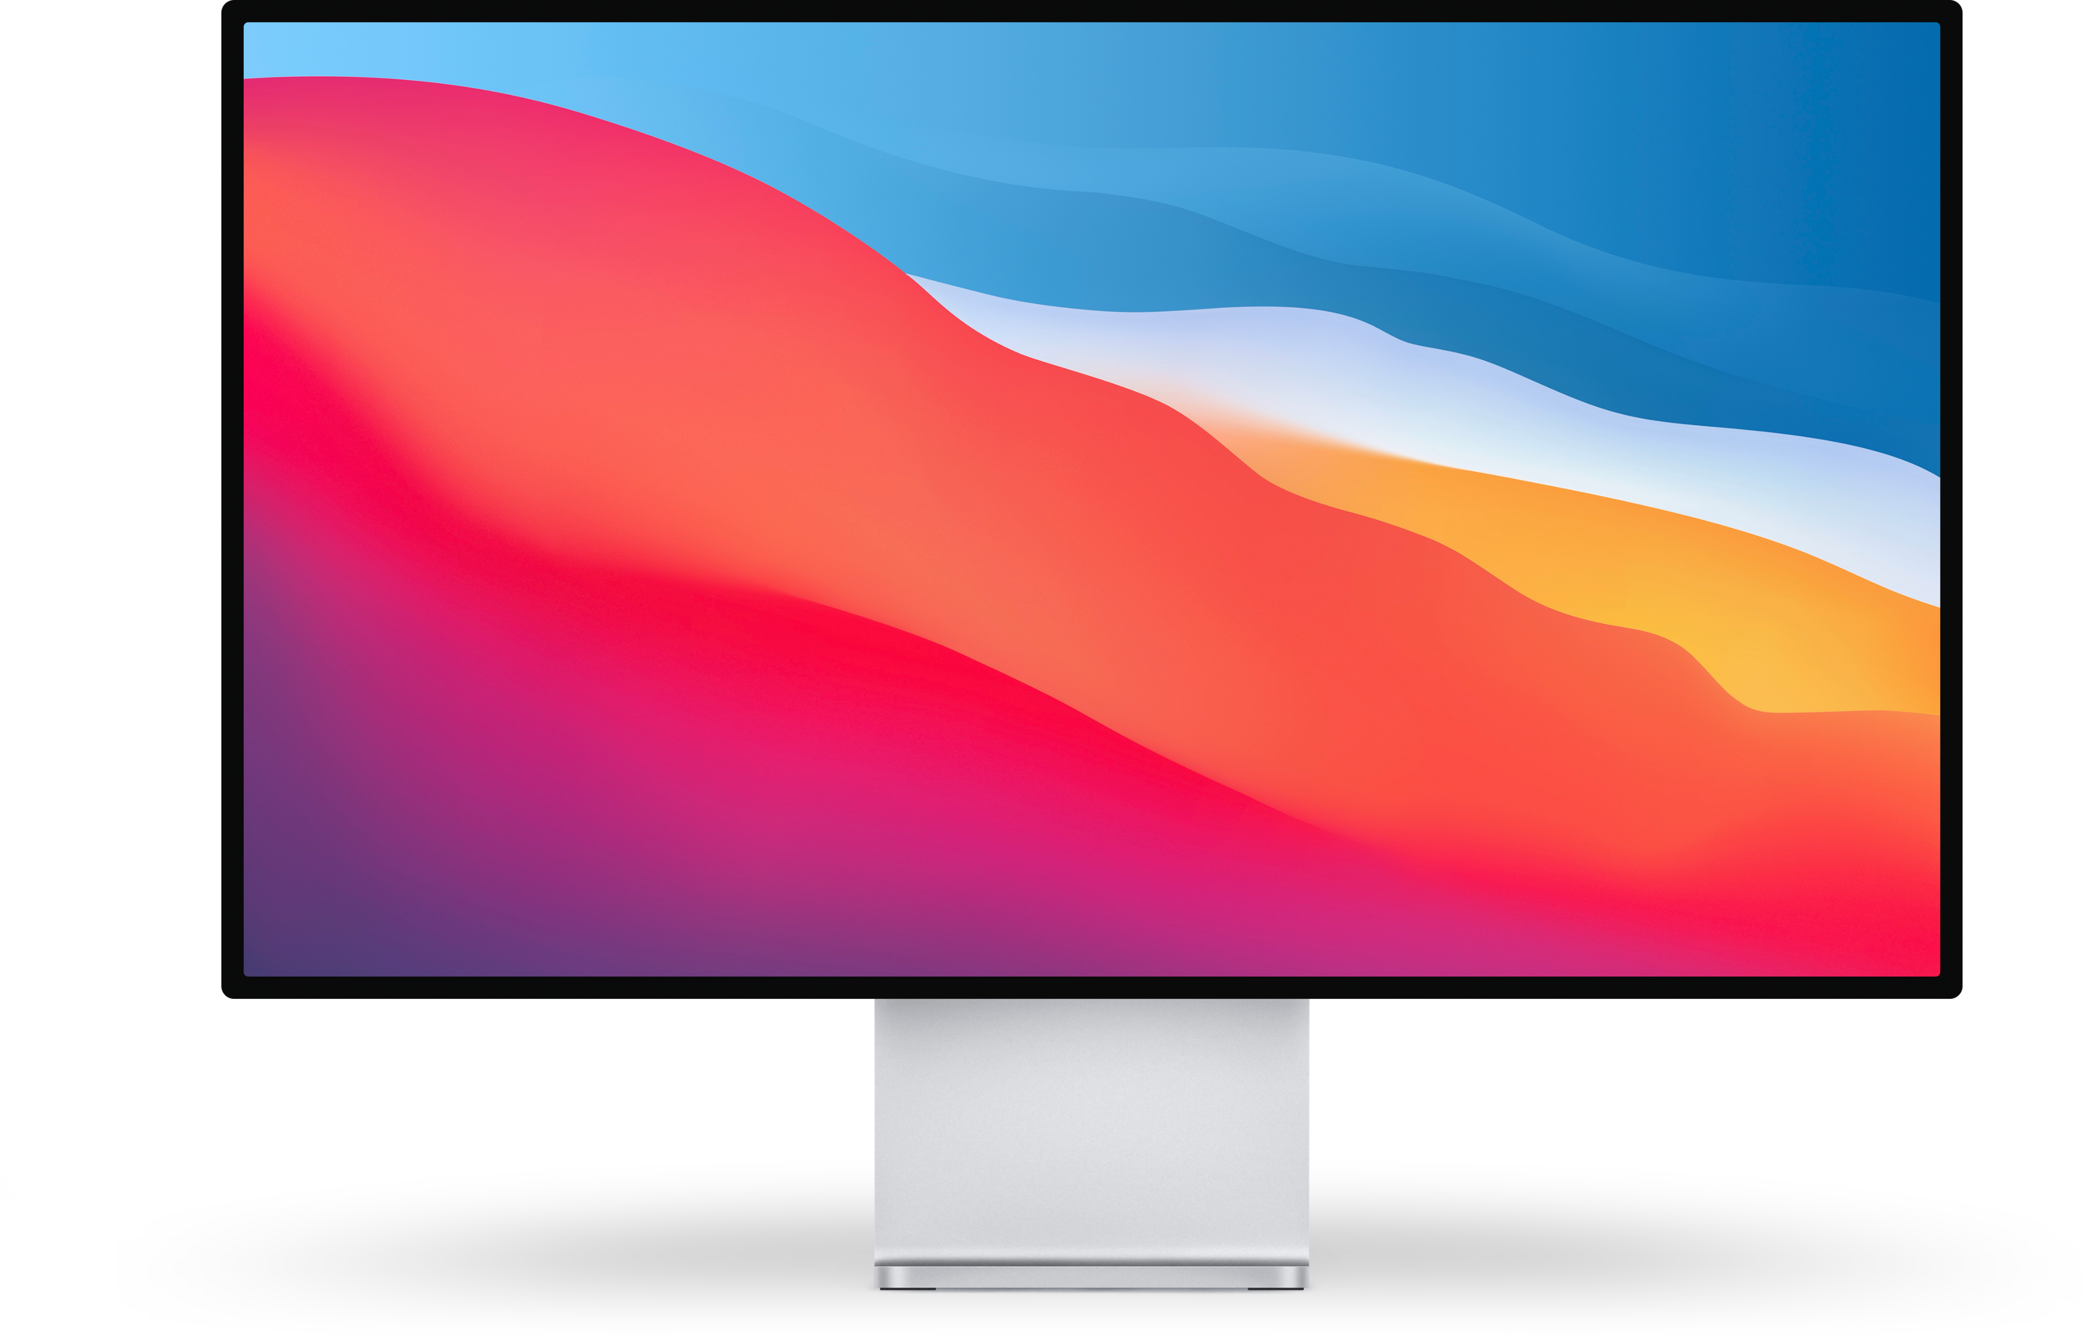
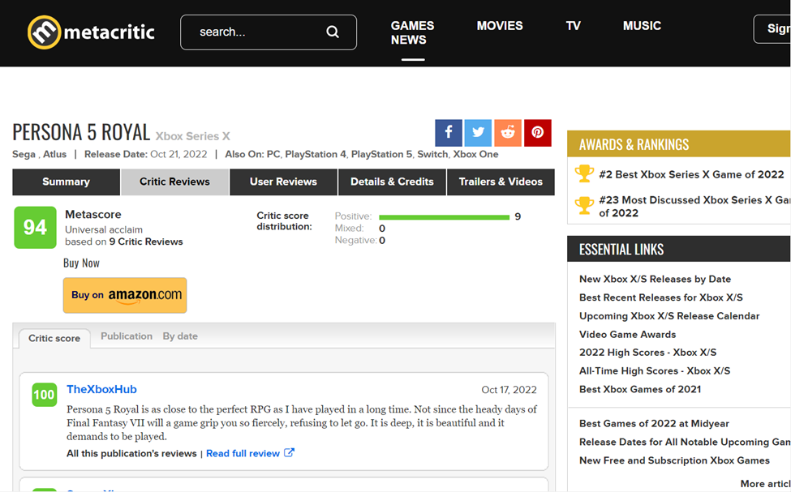
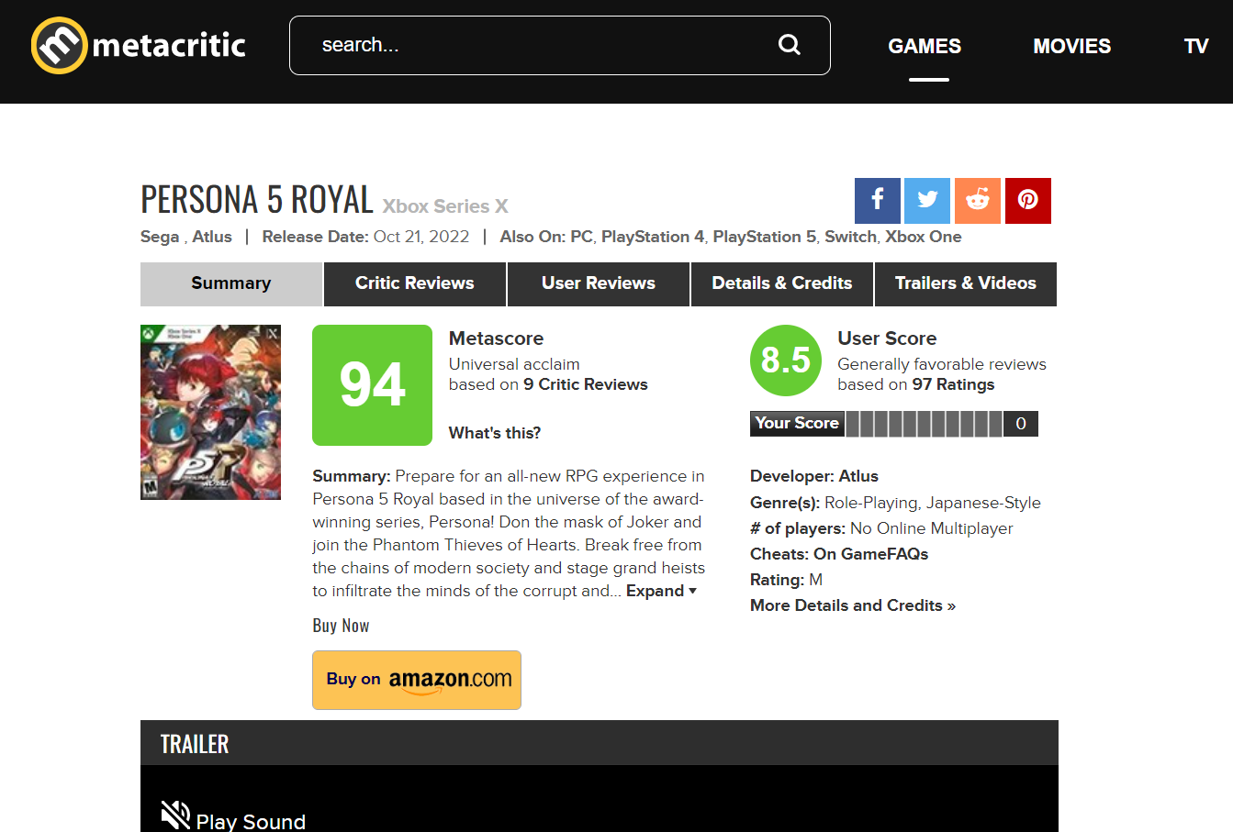


RESEARCH OBJECTIVES
using Navicat
Automatically Visualize and
Reinterpret Valuable Data using
Database Query System
Highly Readable Easy for Web Scraping
Only for The Player’s
Information is Both Loose and Single
Reflecting Boarder Current Circumstance of Game Industry, and at Last Generate Visualized and Highly Readable Corresponding Industry Analysis and Reporting with Both Depth And Breadth, by Self-selecting Different Analysis Dimensions and Factors.

Slide 5
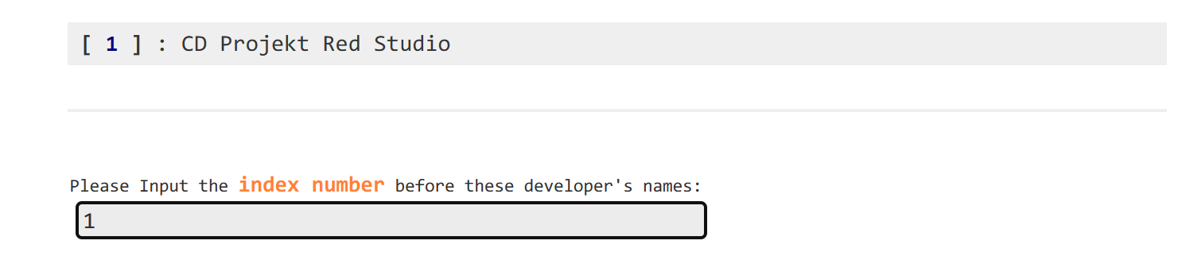
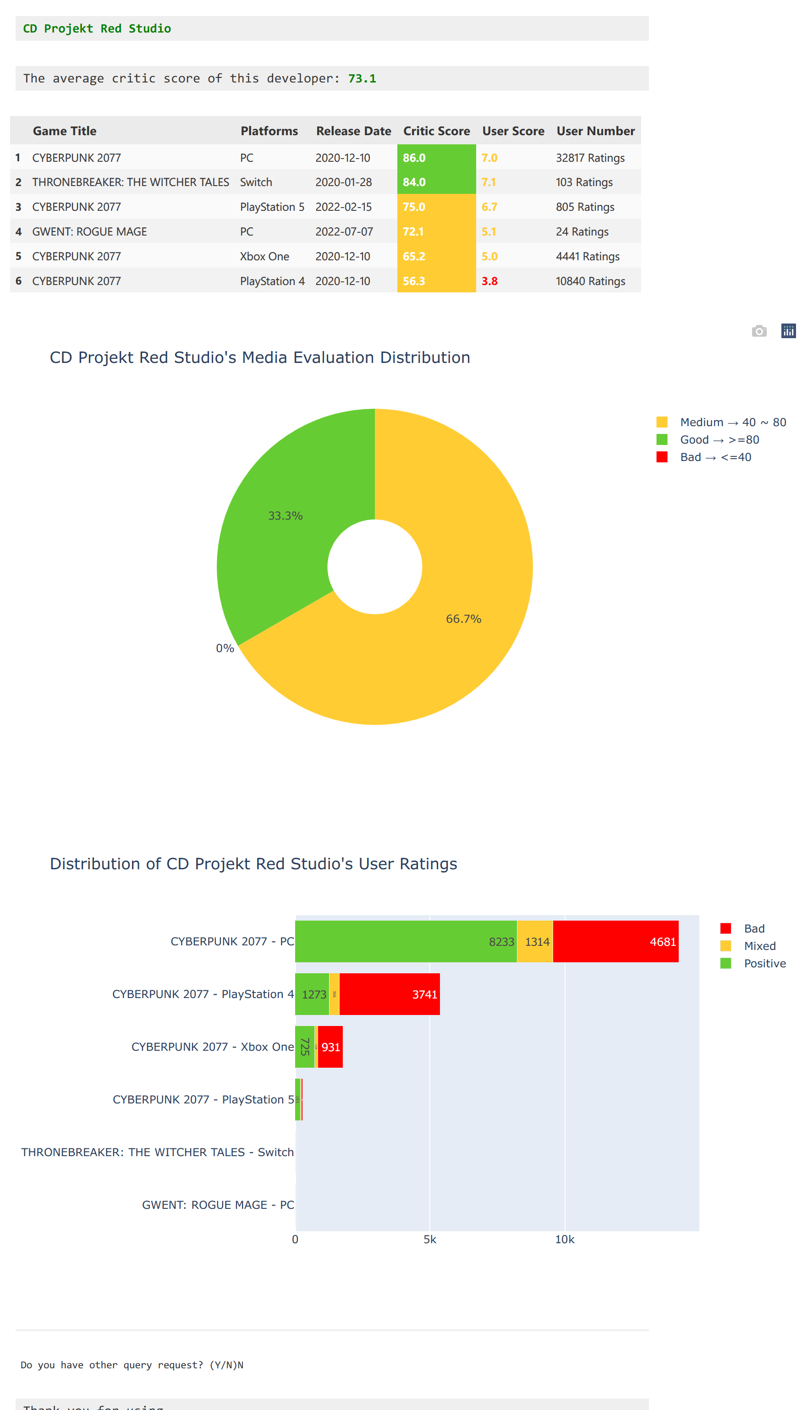
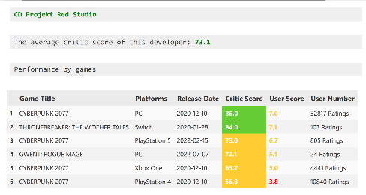
TEMPLATE 2
Query Game Developer Data
Relevant statistical results for this game developer
{CD Projekt red studio}'s average media score was {73.1}, and {33.3%} of critic rated the game developer as a good rating. Of all the games developed by the developer, it was {Cyberpunk 2077}, with {8,233} users giving positive reviews.

Slide 6
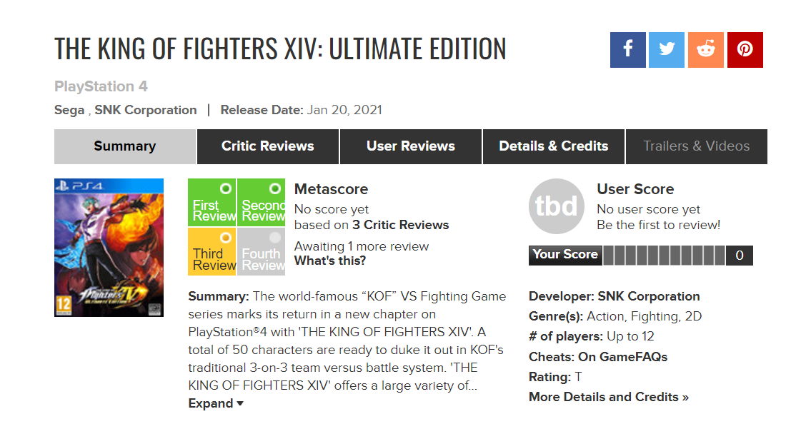
TEMPLATE 2
Metacritic's website flaws:
Due to system problems, some games do not display the corresponding media ratings, but in fact some media have rated them, and these scores are recorded in the media_views table after web scraping.
Critic_Score
Null?
AVG(critic_grade)
FROM media_views
WHERE G_ID = ?
Still Null?
The system will determine that it is a null value and return "TBD"
Critic_Score

Slide 7
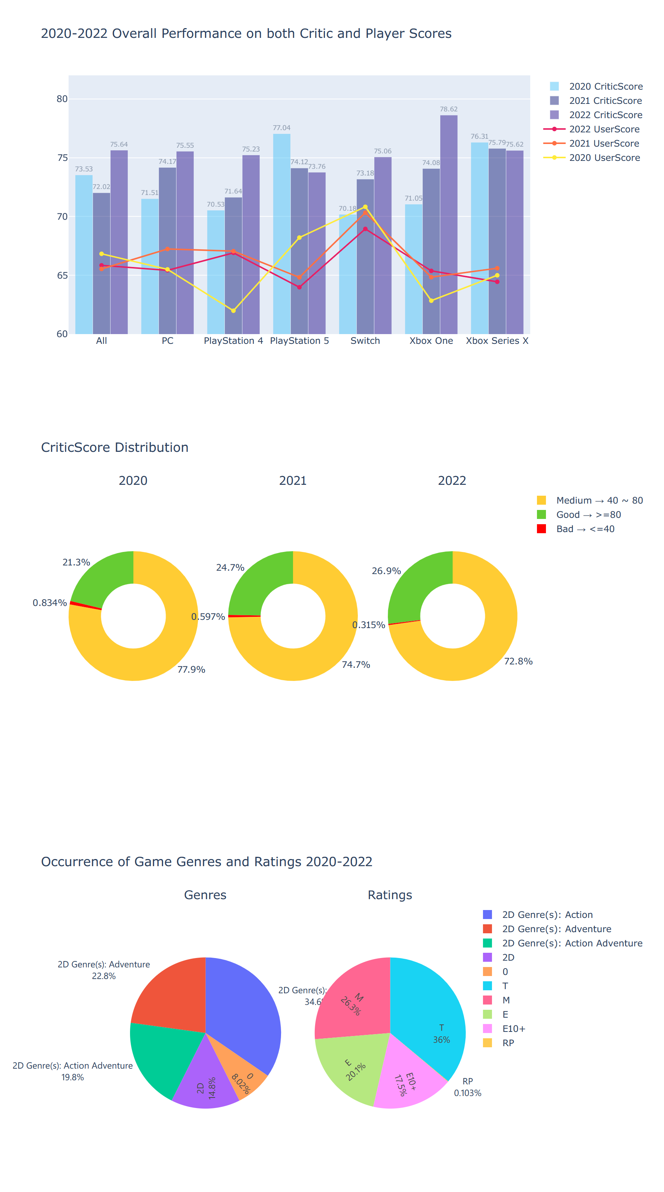
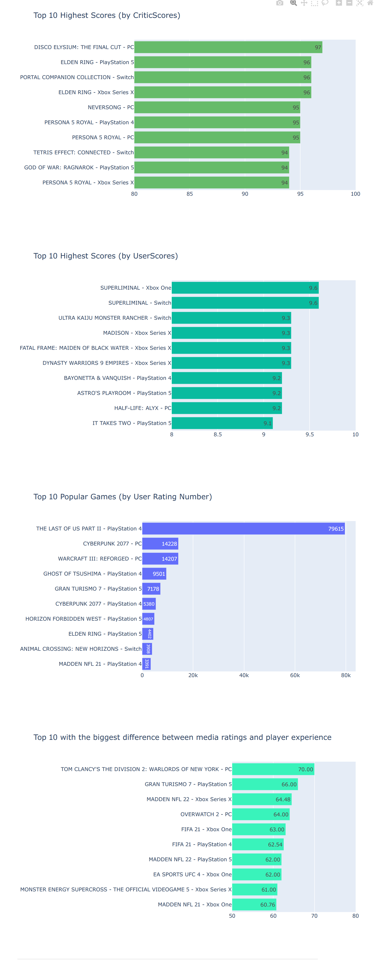
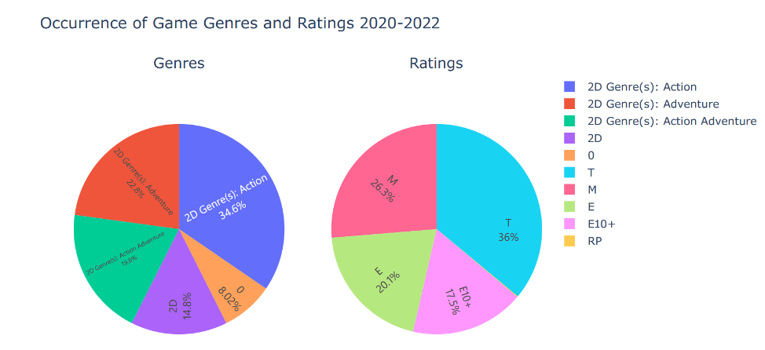
TEMPLATE 5
The 2020-2022 Game Analysis Report
In {2020 to 2022}, the media rating good rating increased by {5.6%} , medium rating by {5.1%} and bad rating by {0.52%}.
The Best Game from 2020 to 2022 is {DISCO ELYSIUM: THE FINAL CUT - PC} considered by media.
The Best Game from 2020 to 2022 is {SUPERLIMINAL - Xbox One} considered by users.
The Biggest Difference (in user and media reviews) Game between 2020-2022 is {TOM CLANCY'S THE DIVISION 2: WARLORDS OF NEW YORK-PC}
The Most Popular Game from 2020 to 2022 is {THE LAST OF US PART 2 - PlayStation4}.
The most frequent genre between{2020-2022} was{2D genre: Adventure}, which accounts for {22.8%} of all genres. The most frequent game level between {2020-2022} was the {T} level, accounting for {36%} of all levels.

Slide 8
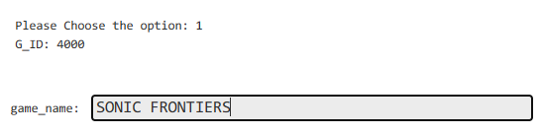
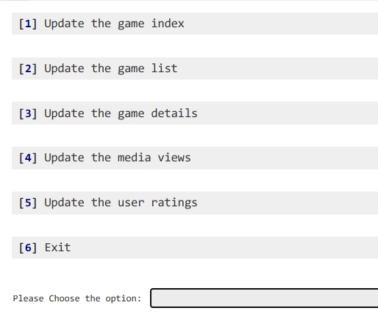
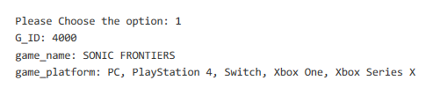
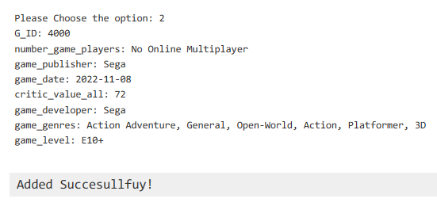
INSERTION
Insert new row into databases
Easily alter all value of new rows

